Slide 1
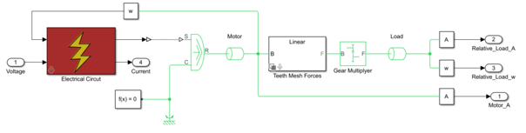
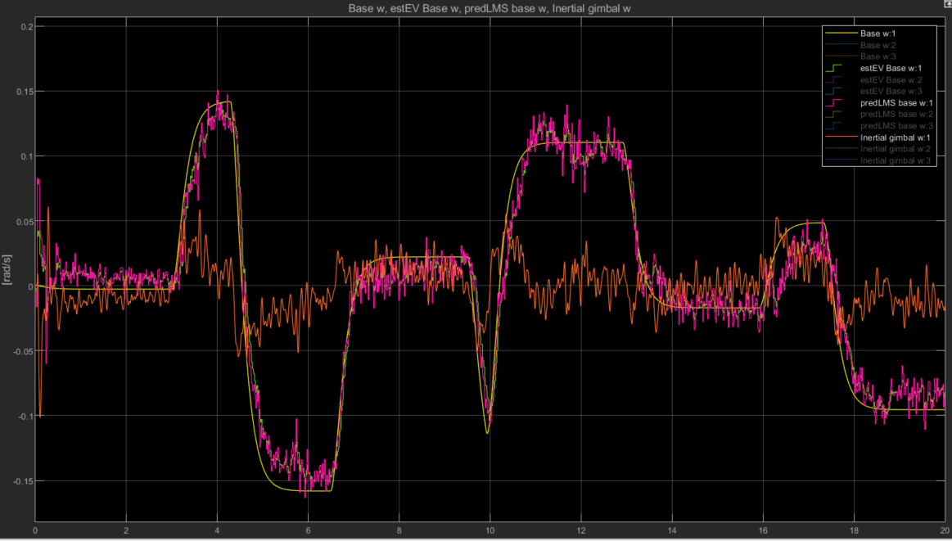
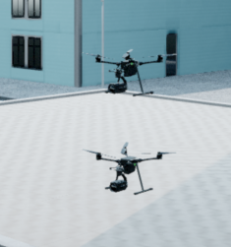
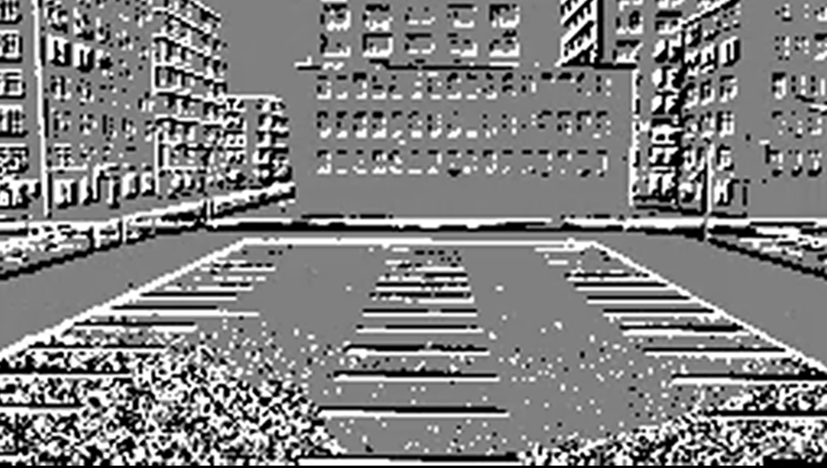
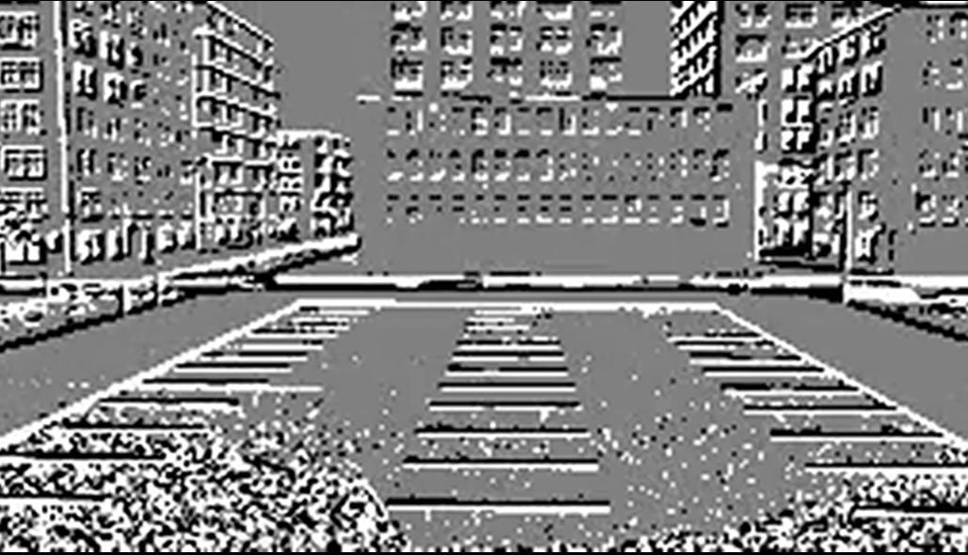
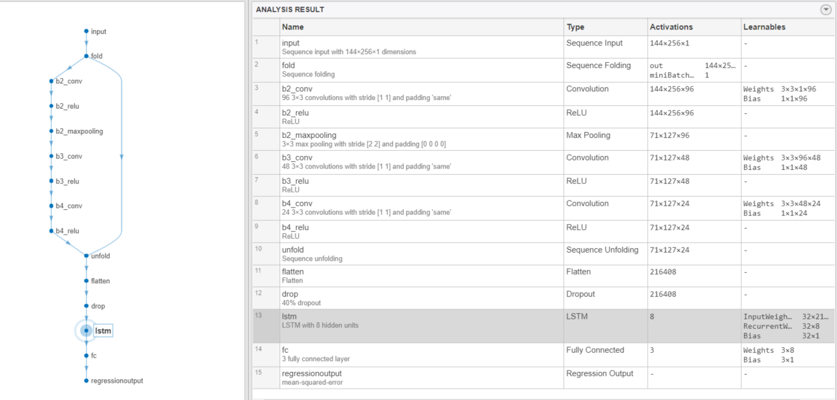
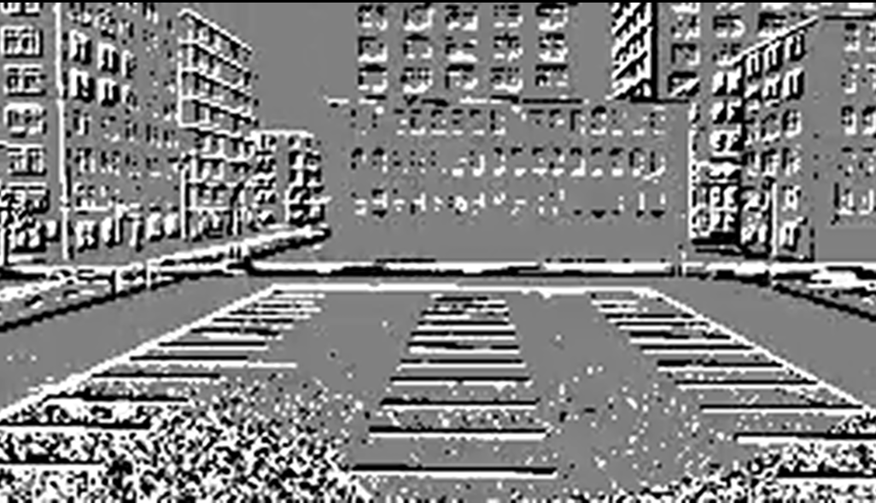
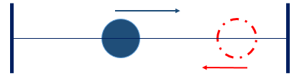

Event Camera Stabilization
$$…$$

Slide 2
Table of Contents
Matlab Simulation Structure
Simulator – Unreal Environment
Plant + Controllers
Event Camera Model
DataSet Creator
Training Process
Estimation Results – Roll Only
nLMS Predictor for Improvement
Stabilization Results
Additional Acquired knowledge
Further Research possibilities

Slide 3
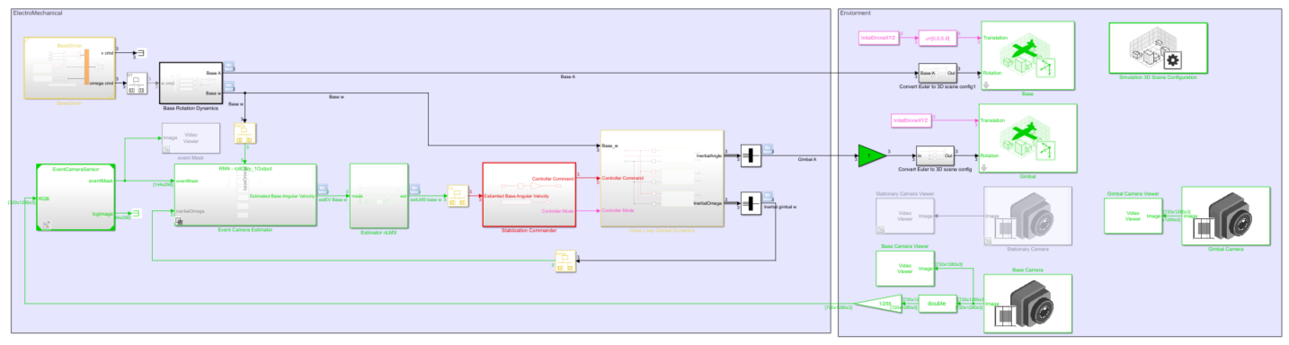
Matlab Simulation Structure
Unreal Environment
Base Command and Dynamics
Gimbal Close Loop
Camera on Gimbal
EventCamera Model
Command to Controller
Deep learning estimator
nLMS Predictor
Camera on Base

Slide 4
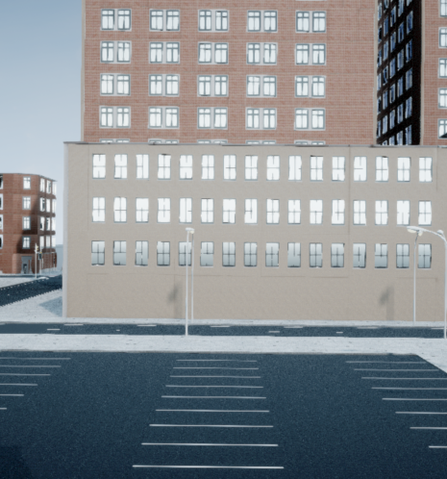
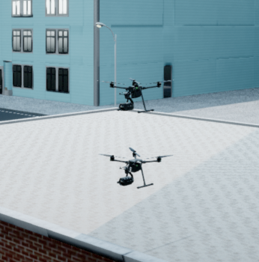
2) Simulator – Unreal Environment
We use two drones to simulate the Base+Gimbal configuration only for the purpose of connecting easily to the simulation environment. Simulink allows the installation of cameras on drones or on a stationary platform. The gimbal is attached to the base in the simulation’s math.
The Event camera is installed on the Base to allow acquiring events during stabilization. A stabilized gimbal has angular rates approaching zero.
The site chosen inside the simulation was a parking-lot with a lot of white lines, to allow for easy testing and calibration of our methods.
Base
Gimbal
Typical view from base’s camera before applying EventCamera Model

Slide 5
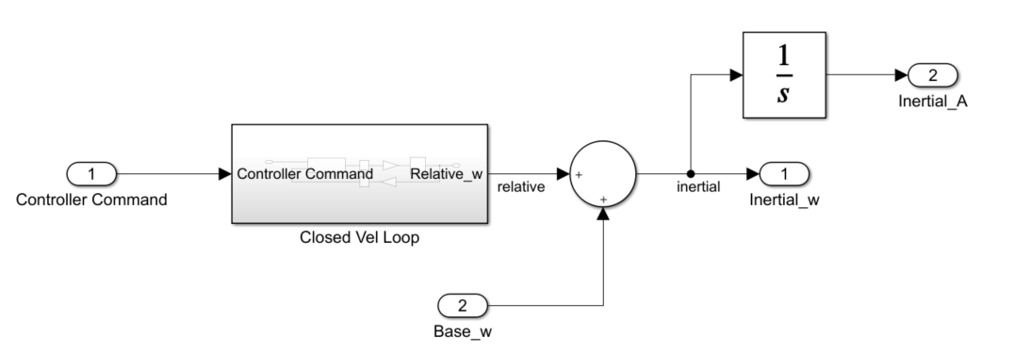
3) Plant + Controllers – Simple Gimbal Model
Sample times:
Control sample time = 0.0008[sec]
Camera sample time = 0.016[sec] (fastest for Simulink-Unreal connection)
Continuous solver (ode 45) for plant models
Important Note: We put emphasis on the modeling as our goal is stabilization: Given an estimate of the state, establish torque through the motors that minimizes the inertial velocity. Torque is related to velocity through Newton’s second law which describes physical dynamical systems.
Relative – Inertial angles:

Slide 6
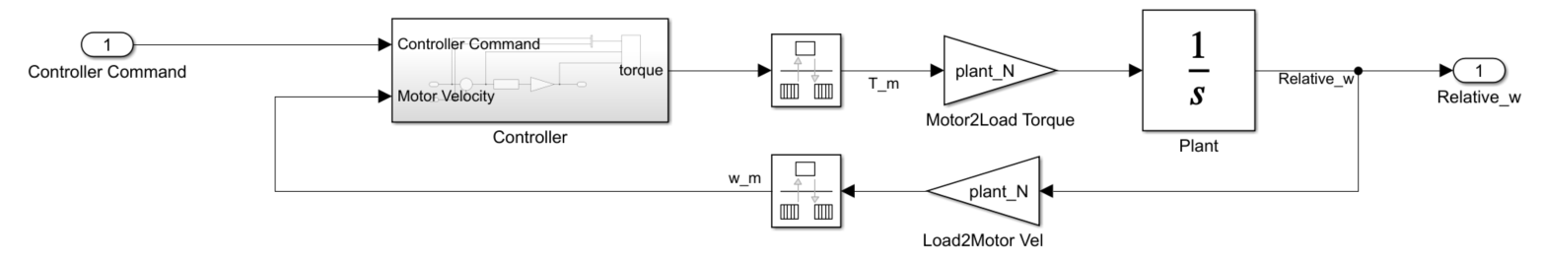
3) Plant + Controllers – Simple Gimbal Model
Simple Closed Loop Design

Slide 7
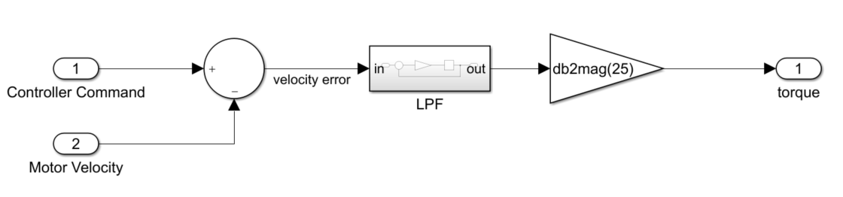

3) Plant + Controllers – Simple Gimbal Model
$$−Estiamted Base Velocity⋅Gear Transmission$$
Simple Closed Loop Design

Slide 8
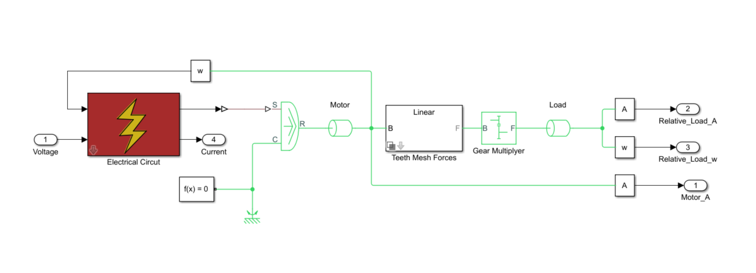
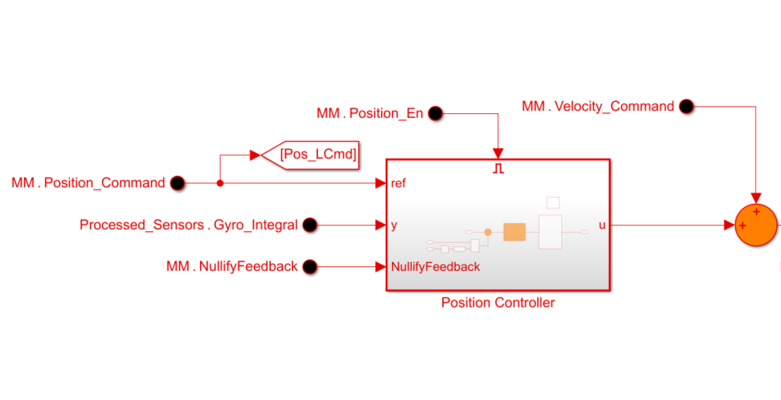
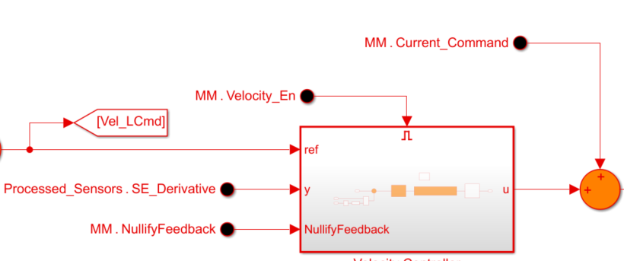
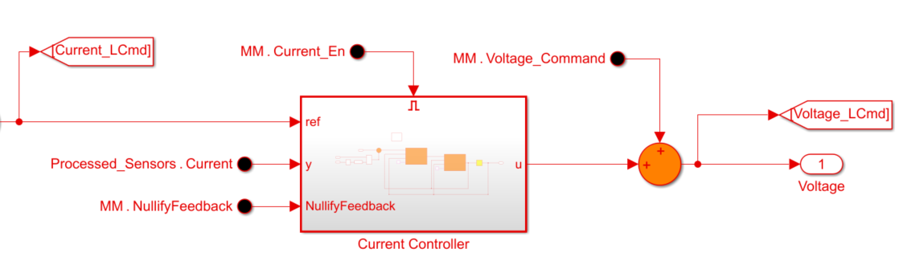
3) Plant + Controllers – Complex Model
Plant:
The complex model includes 2 masses (motor and load) connected by gear with stiffness and viscosity for each axis
Controllers:
The controllers are made of classic control blocks – PID, Notch,Lead-Lag anti wind up.
Physical plant
Cascaded Controllers

Slide 9
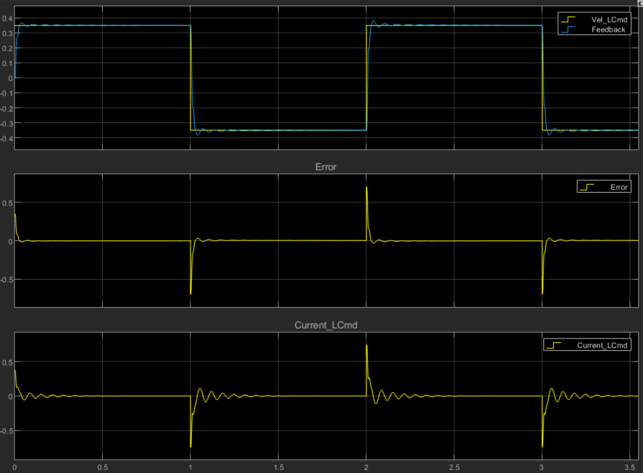
3) Plant + Controllers – Complex Model
The Complex model’s response for velocity step commands – “corner stone” is set.

Slide 10
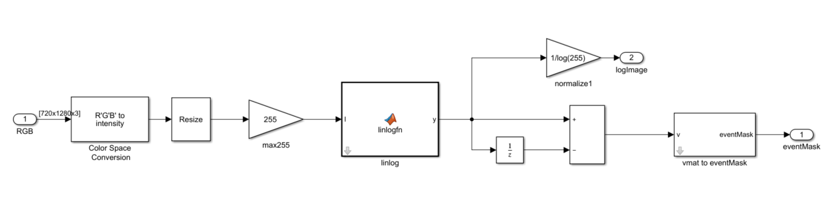
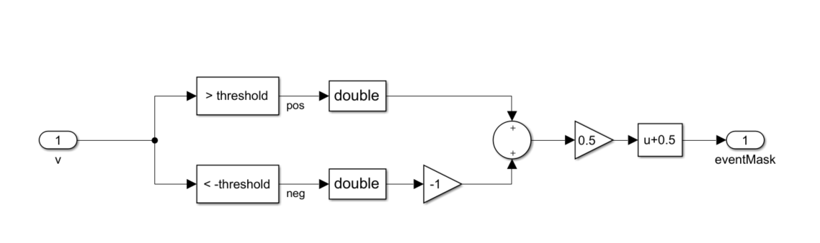

4) Event Camera Model
The model includes a linlog function which aim’s to simulate the sensor’s dynamic range and normalize pixel values between 0-log(255).
The threshold value for the pixel’s change rate to activate an event was set to $3.125⋅camera sample time=0.05\left[\frac{Intensity}{s}\right]$

Slide 11
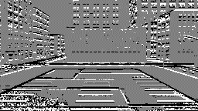
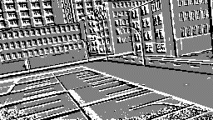
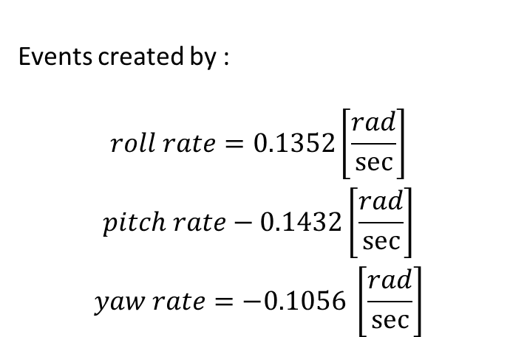
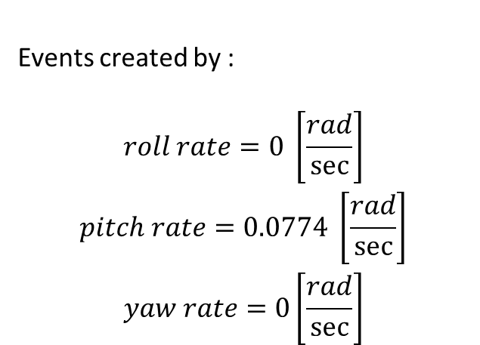
4) Event Camera Model- Event Frames Example
Note: We chose a parking spot with urban buildings that have many windows. We thought that the re-occurring, evenly spaced lines that act as rulers will help us solve a small problem before taking on a big one. We noticed these also input ambiguity to the system that will be explained in further slides.
Events created by :
$$\begin{matrix}roll rate=0 \left[\frac{rad}{sec}\right] \\ pitch rate=0.0774 \left[\frac{rad}{sec}\right] \\ yaw rate=0\left[\frac{rad}{sec}\right]\end{matrix}$$
Events created by :
$$\begin{matrix}roll rate=0.1352\left[\frac{rad}{sec}\right] \\ pitch rate−0.1432\left[\frac{rad}{sec}\right] \\ yaw rate=−0.1056 \left[\frac{rad}{sec}\right]\end{matrix}$$

Slide 12
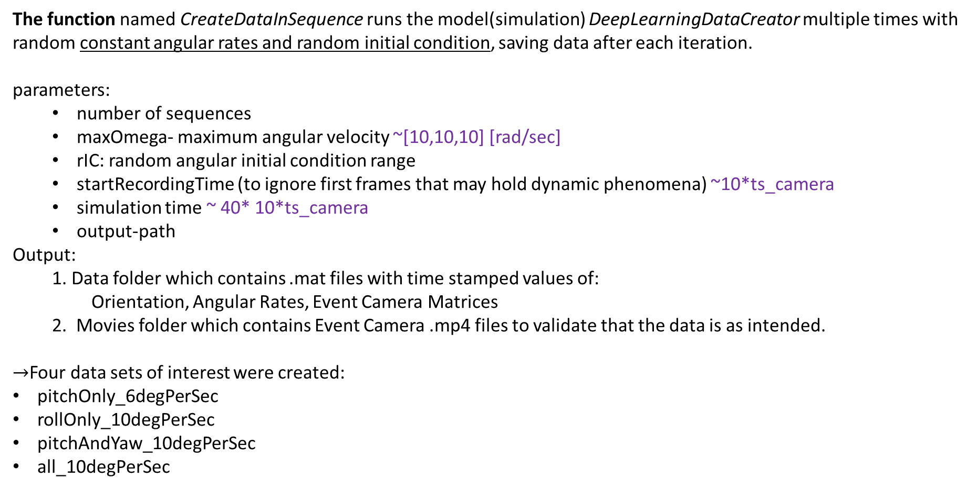
5) DataSet Creator
The function named CreateDataInSequence runs the model(simulation) DeepLearningDataCreator multiple times with random constant angular rates and random initial condition, saving data after each iteration. parameters:
number of sequences
maxOmega- maximum angular velocity ~[10,10,10] [rad/sec]
rIC: random angular initial condition range
startRecordingTime (to ignore first frames that may hold dynamic phenomena) ~10*ts_camera
simulation time ~ 40* 10*ts_camera
output-path
Output:
1. Data folder which contains .mat files with time stamped values of:
Orientation, Angular Rates, Event Camera Matrices
2. Movies folder which contains Event Camera .mp4 files to validate that the data is as intended.
$→$Four data sets of interest were created:
pitchOnly_6degPerSec
rollOnly_10degPerSec
pitchAndYaw_10degPerSec
all_10degPerSec

Slide 13
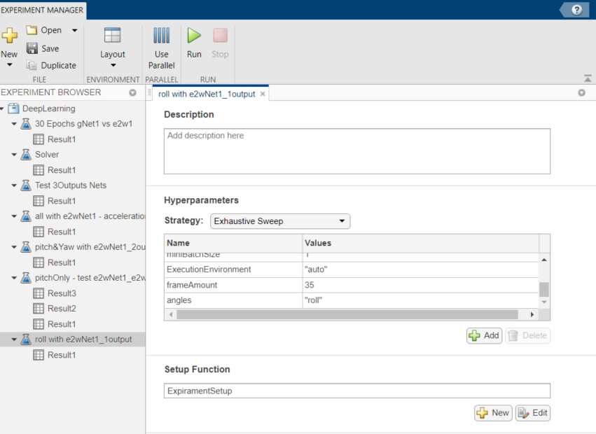
6) Training Process
We used MATALB’s Experiment Manager to test different network architectures, and training hyper parameters on different data sets to obtain confidence in our network design:
1) Pitch only with a simple network
2) Pitch only with googleNet based network
3) Pitch + Yaw with a simple network and more mini batches
4) And so on…

Slide 14
6) Training Process – Chosen Model
e2wNet1 – Chosen Architecture

Slide 15
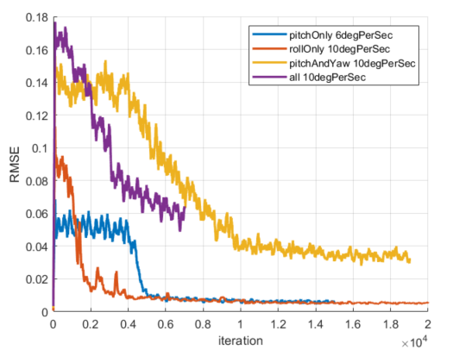
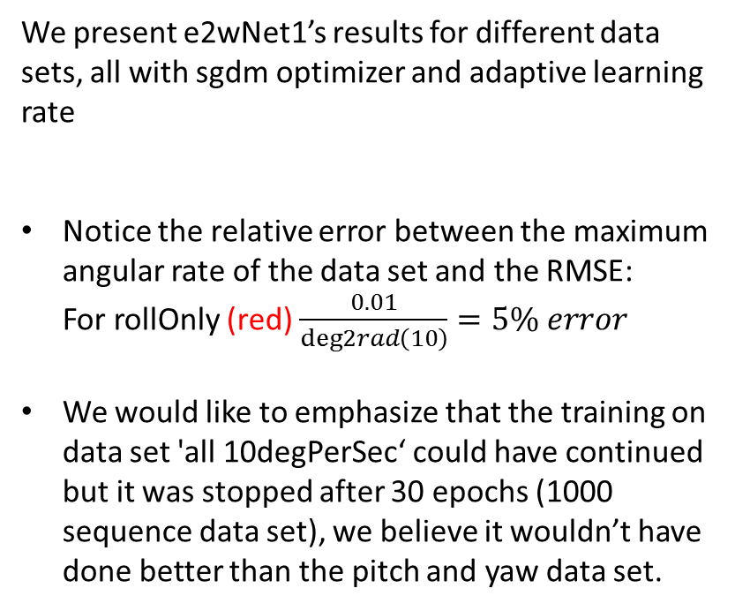
6) Training Process - RMSE
We present e2wNet1’s results for different data sets, all with sgdm optimizer and adaptive learning rate
Notice the relative error between the maximum angular rate of the data set and the RMSE: For rollOnly (red) $\frac{0.01}{deg2rad\left(10\right)}=5\% error$
We would like to emphasize that the training on data set 'all 10degPerSec‘ could have continued but it was stopped after 30 epochs (1000 sequence data set), we believe it wouldn’t have done better than the pitch and yaw data set.

Slide 16
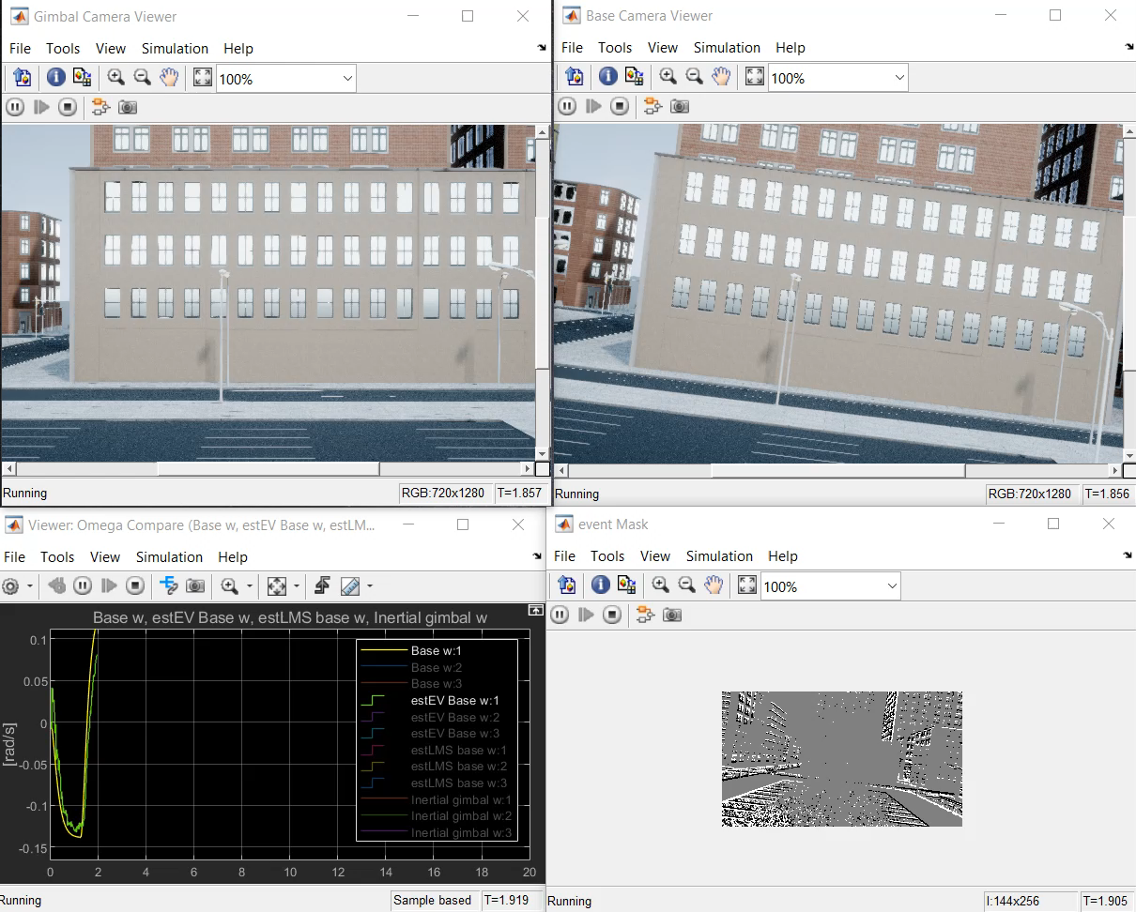
7) Estimation Results - RollOnly
Input to Estimator: 11 event frames
Legend:
Top Left – Stabilized Camera on Gimbal
Top Right – Camera installed on Base
Bottom Left – Base Roll Estimation
Bottom Right – Event Camera’s State

Slide 17
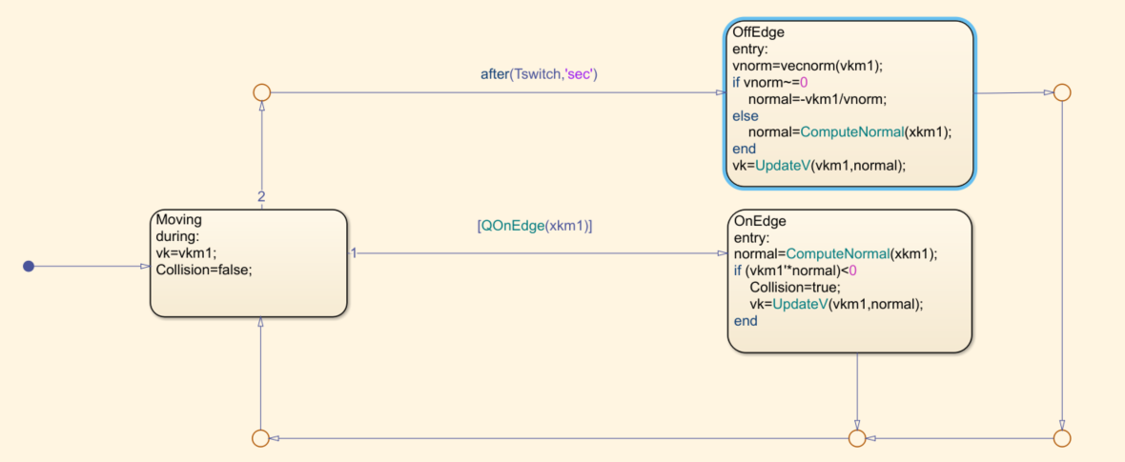
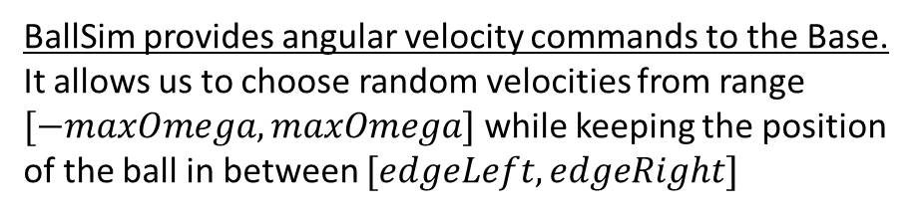
Results – BallSim
Before collision
BallSim provides angular velocity commands to the Base. It allows us to choose random velocities from range $[−maxOmega,maxOmega]$ while keeping the position of the ball in between $[edgeLeft,edgeRight]$
After collision, updated random velocity

Slide 18
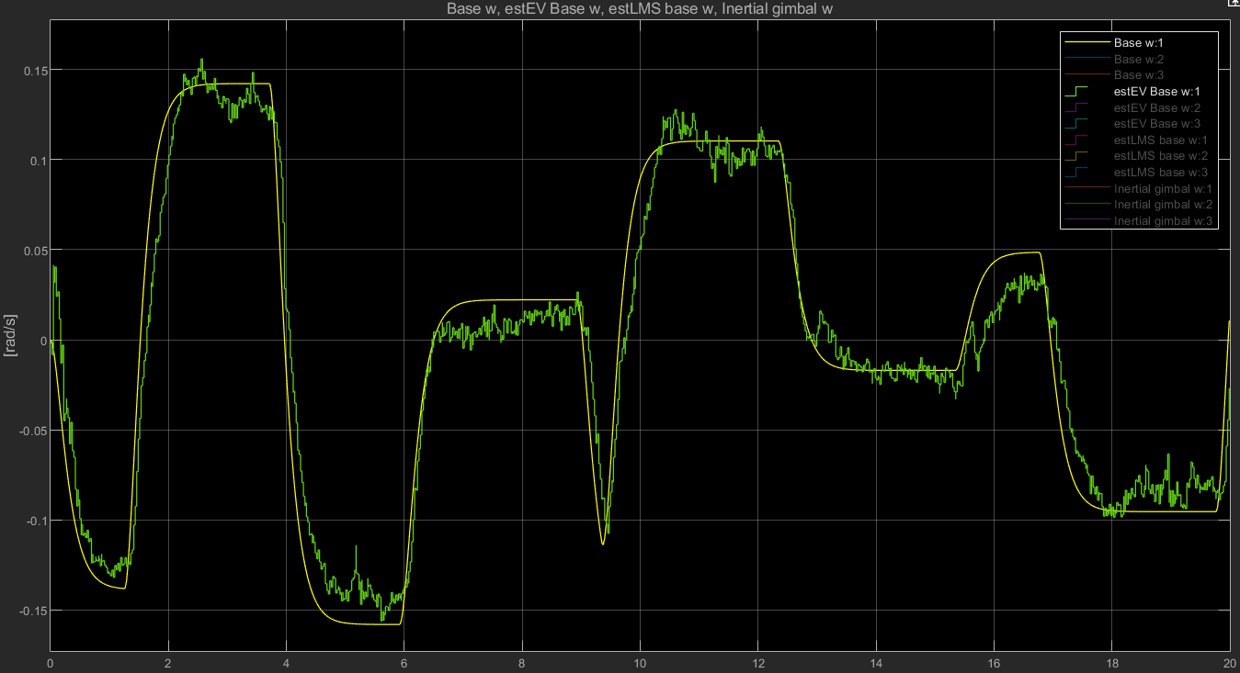
7) Estimation Results – Roll Only, Steps
Interestingly, the estimator converges well when acceleration exists, and starts to stutter when it doesn’t.
Why does this happen? Let’s see if you can answer to which direction the camera moved between state A and B.
A)
B)
Acceleration provides additional directional information. The two frames (A), (B) may not look different, but between a sample of 10 frames, it would be evident.

Slide 19
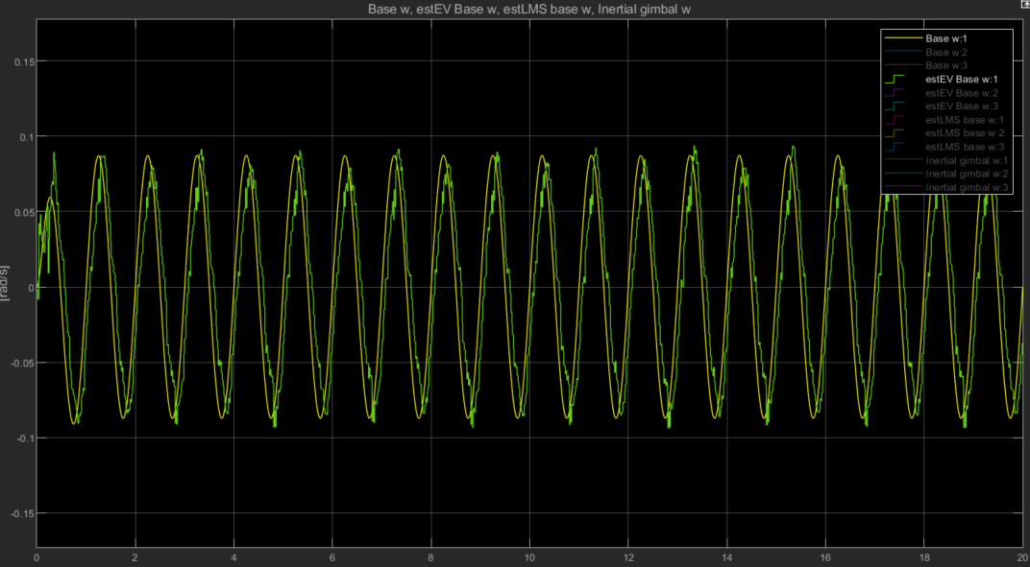
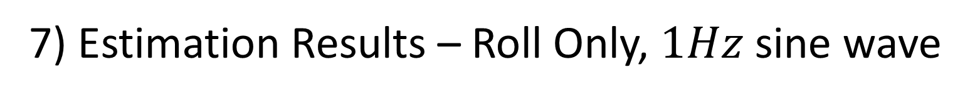
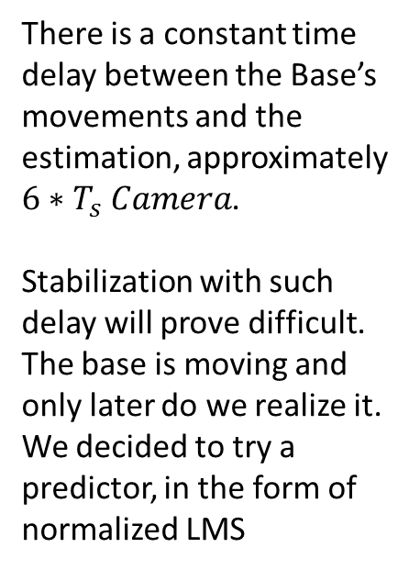
7) Estimation Results – Roll Only, $1Hz$ sine wave
There is a constant time delay between the Base’s movements and the estimation, approximately $6∗T_{s} Camera$.
Stabilization with such delay will prove difficult. The base is moving and only later do we realize it. We decided to try a predictor, in the form of normalized LMS

Slide 20
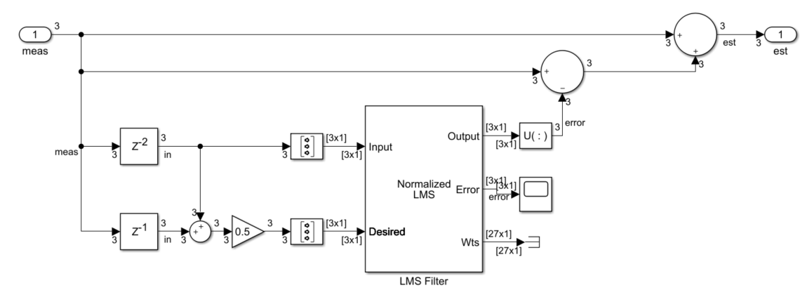
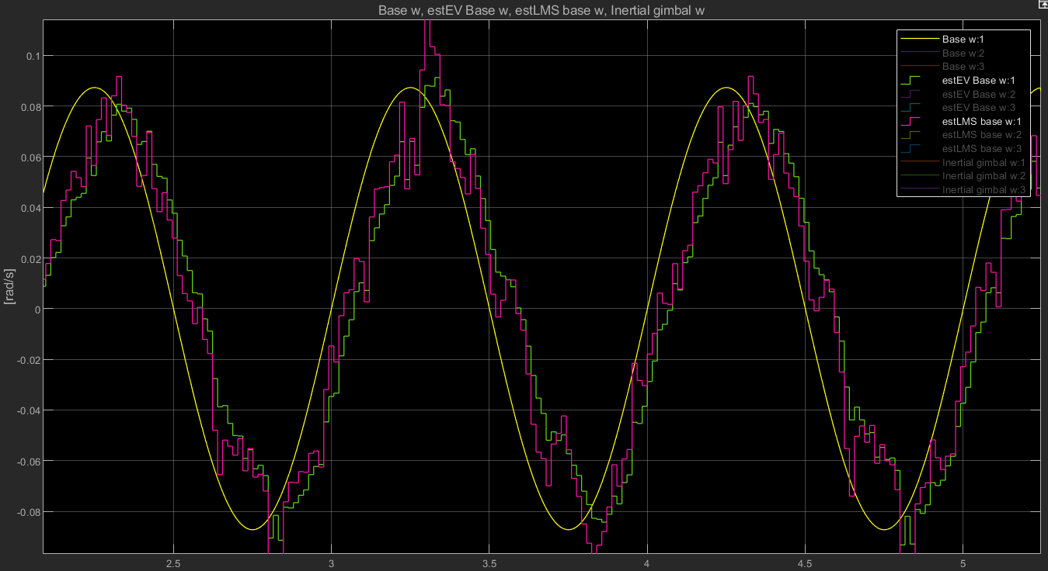
8) nLMS Predictor for Improvement
We gain some of the delay back in expanse of signal volatility which we are less concerned with:
The controller has a low-pass filter built in
Velocity is integrated to position which in-itself has a low-pass filter’s effect

Slide 21
9) Stabilization Results – Roll Only
See how the inertial gimbal angular rate (orange) stays close to zero the entire time.

Slide 22
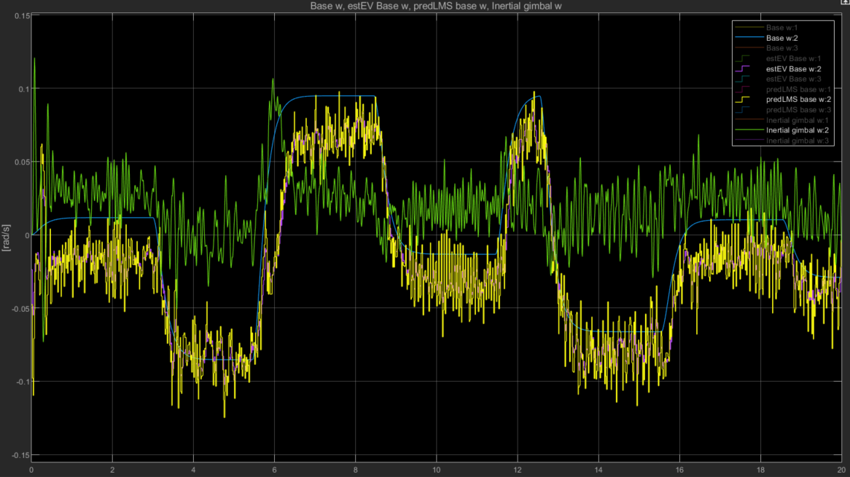
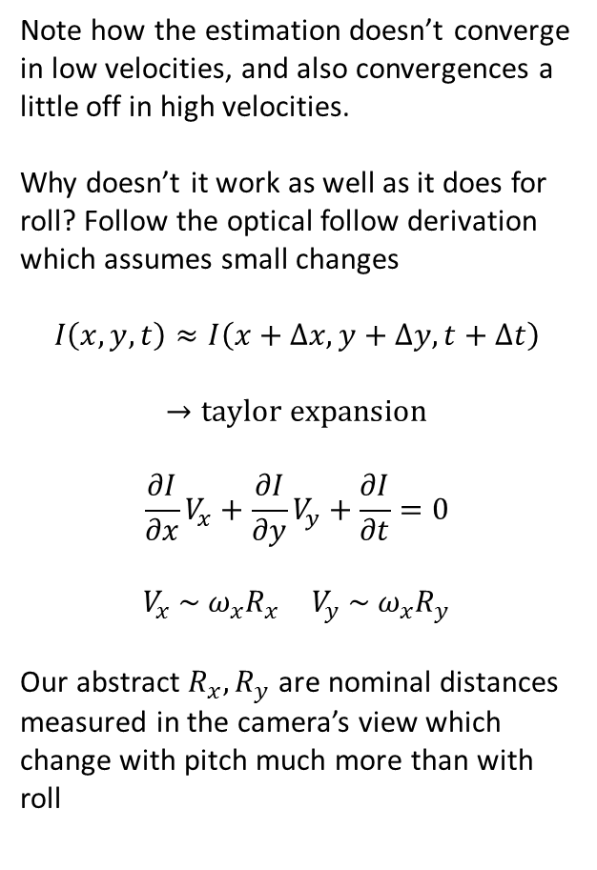
9) Stabilization Results – Pitch Only
Note how the estimation doesn’t converge in low velocities, and also convergences a little off in high velocities.
Why doesn’t it work as well as it does for roll? Follow the optical follow derivation which assumes small changes
$$I\left(x,y,t\right)≈I\left(x+Δx,y+Δy,t+Δt\right)$$
$$→taylor expansion$$
$$\frac{∂I}{∂x}V_{x}+\frac{∂I}{∂y}V_{y}+\frac{∂I}{∂t}=0$$
$$\begin{matrix}V_{x} \sim ω_{x}R_{x} & V_{y} \sim ω_{x}R_{y}\end{matrix}$$
Our abstract $R_{x},R_{y}$ are nominal distances measured in the camera’s view which change with pitch much more than with roll

Slide 23
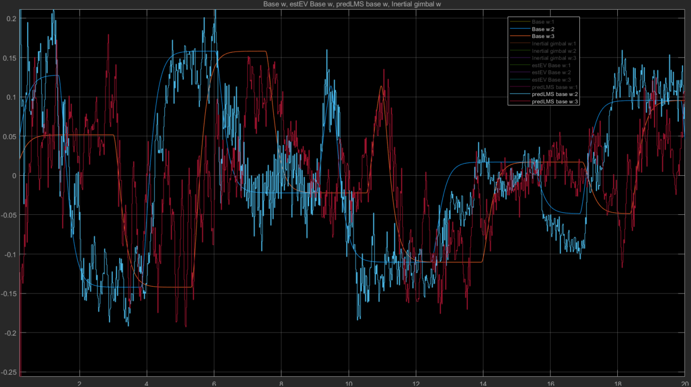
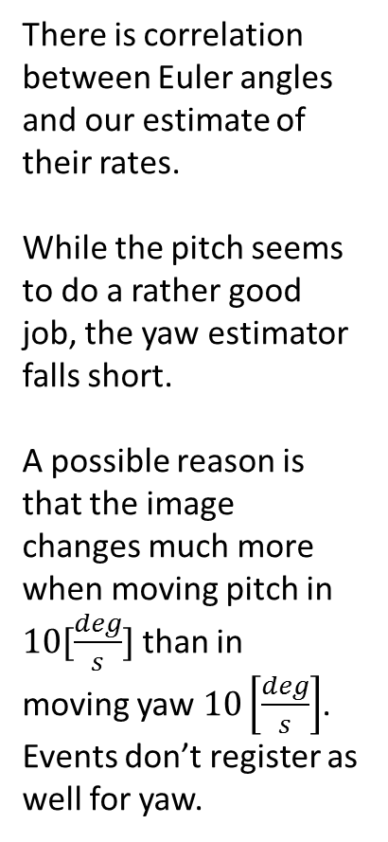
9) Stabilization Results – Pitch and Yaw
There is correlation between Euler angles and our estimate of their rates. While the pitch seems to do a rather good job, the yaw estimator falls short. A possible reason is that the image changes much more when moving pitch in $10[\frac{deg}{s}]$ than in moving yaw $10\left[\frac{deg}{s}\right]$. Events don’t register as well for yaw.

Slide 24
10) Additional Acquired knowledge
Spike neural network
Python-Matlab co-simulation:
Introducing python code into Simulink environment
Executing discrete Simulink simulation in Python environment through Simulink code generation
Python Gym simulation environment
Reinforcement learning in Matlab+Simulink syntax and requirements. With our limited resources we didn’t pursuit the training of the agent.

Slide 25
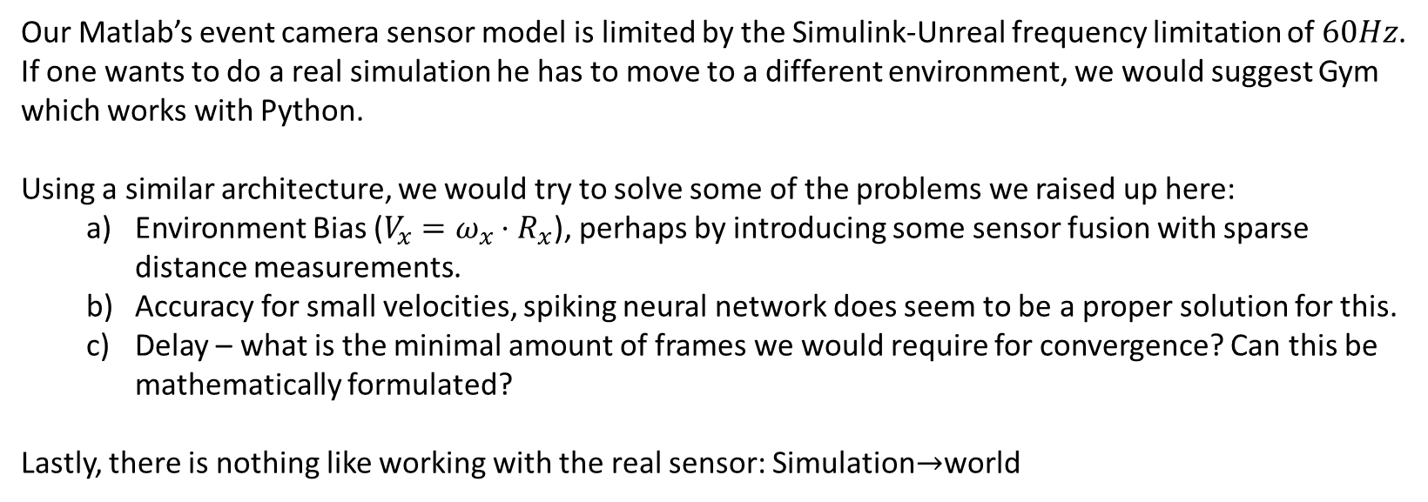
11) Further Research possibilities
Our Matlab’s event camera sensor model is limited by the Simulink-Unreal frequency limitation of $60Hz$. If one wants to do a real simulation he has to move to a different environment, we would suggest Gym which works with Python.
Using a similar architecture, we would try to solve some of the problems we raised up here:
Environment Bias ($V_{x}=ω_{x}⋅R_{x}$), perhaps by introducing some sensor fusion with sparse distance measurements.
Accuracy for small velocities, spiking neural network does seem to be a proper solution for this.
Delay – what is the minimal amount of frames we would require for convergence? Can this be mathematically formulated?
Lastly, there is nothing like working with the real sensor: Simulation$→$world

Slide 26
Thank you
Guy Rotem
Alon Spinner

